Slide 1


Movie Industry Segmentation Analysis
Enrique
Grace
Isaac
Carolina

Slide 2

Basic Exploratory Data Analysis using Pandas
Reading the data: Our data is stored in Comma Separated Value (CSV):
IMDB Movies, IMDB Ratings, Oscar Awards
Familiarizing with the data:
Pull first records by using .head()
Count blanks and non-blanks
Identify columns relevant to our analysis: Title ID, Revenue, Date Published, Genre, Country, Director,
Identify Index column to merge data frames: “imdb_title_id”
Analyze Data types in Cols: Some datatype are mixed
Identify scope: Movies from 1970 to 2020

Slide 3

Before using your Pandas martial arts: Clean up your data: “Wax on, Wax off”
Delete irrelevant columns for having too many missing values
Movies_df.drop
Fix columns with inconsistent data types:
Coln Genre: row 1: “Comedy”, row 2: “Comedy, Drama”
Coln Countries: row 1: “USA”, row 2: “USA, France”
Coln Worldwide Gross Income: Datatype is Object.
row 1 “$ 47121859, row 2 “INR 220054”
Coln Year: row 1 is “1980”, row 80,200 is “Movie Year is 2020”
Panda weapons:
Split text: movies_df_removed_index_1970["genre"].str.split(",", n=1, expand = True)
def clean_currency(currency: str) -> float
if currency[0].isnumeric() try float_value = float(currency)
Coln Year: row 1 is 1980, row 80,454 is “Movie Year is 2020

Slide 4
OUR GOALS
Two-Part Analysis:
Award-Winning Strategy:
Do higher-rated movies necessarily result in higher award counts?
What are other variables that can impact the award counts?
Revenue Generation Strategy:
How to get higher revenue on movies? What are the variables impacting revenues?
Do higher-rated movies also result in higher revenues?
Does the audience have an impact on revenues?
Coln Year: row 1 is 1980, row 80,454 is “Movie Year is 2020

Slide 5
Award-Related Analyses

Slide 6

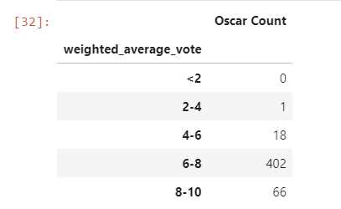
Getting ready for the Award-Related Analysis
Data Merge Magic:
Movies and ratings are merged by IMDB ID.
Merge with Oscar df, Problem: No IMDB ID in Oscar Awards data frame.
Solution: Trim data on “movie titles” by looping through the rows and format each one. Reformat the movie title names show only letters and numbers. Example: From The Great White Hope to TheGreatWhiteHope
Reduce your data and make it relevant:
Create the bins in which Movie Ratings Data will be held. Create List. ratings_group_name = ['<2', '2-4', '4-6', '6-8', '8-10’]
Create rating groups using the dataset with non-duplicate players. ratings_groups = pd.cut
Create data frame to show whether movies with higher ratings tend to receive more awards. Panda function: .groupby
Coln Year: row 1 is 1980, row 80,454 is “Movie Year is 2020

Slide 7
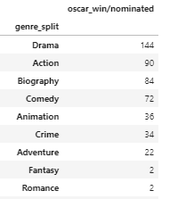
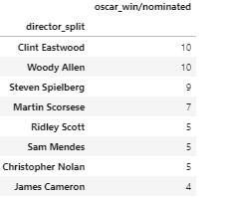
Genre/Director/Actors vs. Award Winnings/Nominations
The Oscar Awards data for our analyses and hereby suggest the following:
The most awarded favored movie genre is Drama
Panda weapons:
Group by method:
Grouped by genre & directors
Then sorted awards in descending order

Slide 8
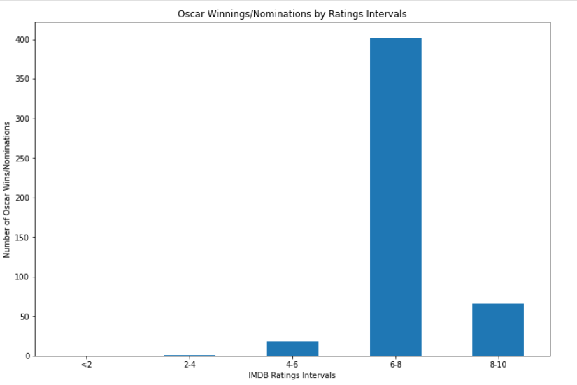
Movie ratings vs. Awards
How does ratings impact award winnings?
Highest ratings do NOT necessarily result in highest award counts
Several hypothesis of why that happened:
A lot of Oscar winnings/nominations (i.e., Art Direction, Costume Design, Make-up & Styling, etc.) are given to non-high-rating movies (aka, falls into the range of 6-8).
Is the number of USA movies a reason of this situation?

Slide 9
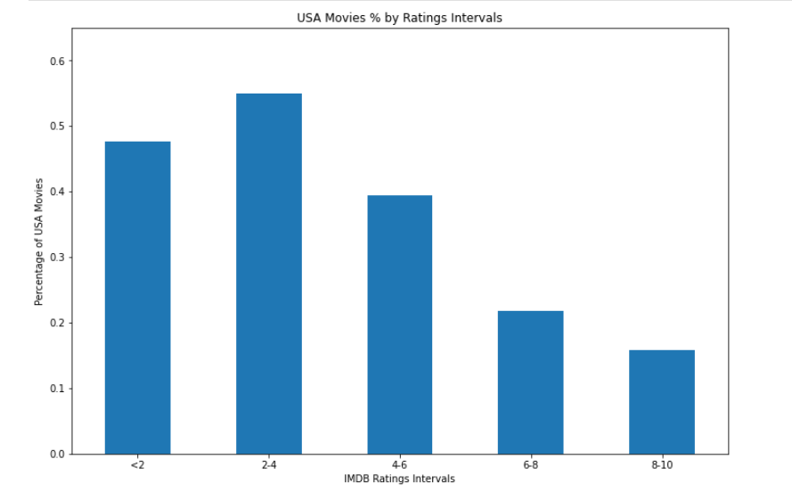
Movie ratings vs. USA movies
What are the differences & similarities between this and the last graph?
USA movies % has the highest numbers in lower rating intervals
Higher ratings have lower numbers of USA movies.
Hence, possible conclusions:
Oscar does prefer higher-rated movies, that's why most of the winning/nominated movies are in the 6-8 & 8-10 ranges.
The reason why 8-10 range movies does not have highest award counts is because the population of USA movies in 8-10 rating range is too small.

Slide 10
Revenue-Related Analyses

Slide 11
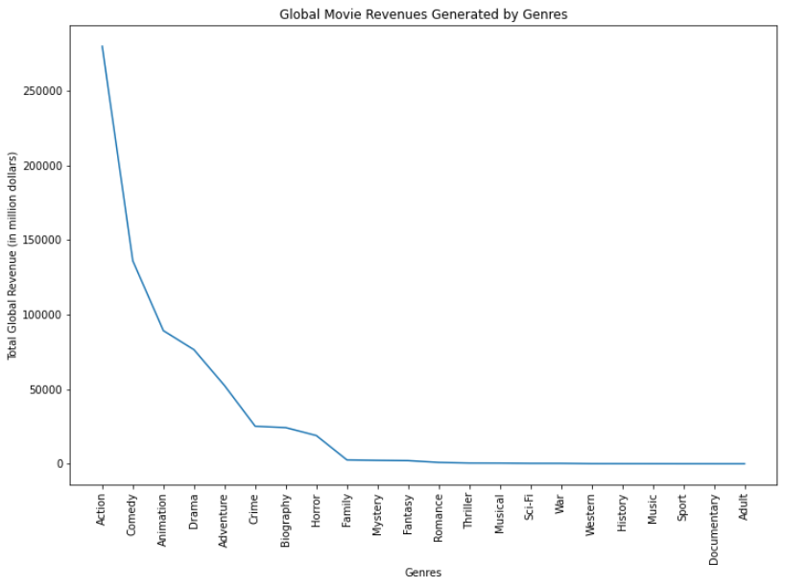
Genres vs. Revenue
Action movies have significant impact on higher revenues, almost doubling the Comedy genre.
Panda weapons:
Group by method:
Grouped by genres and worldwide gross income

Slide 12
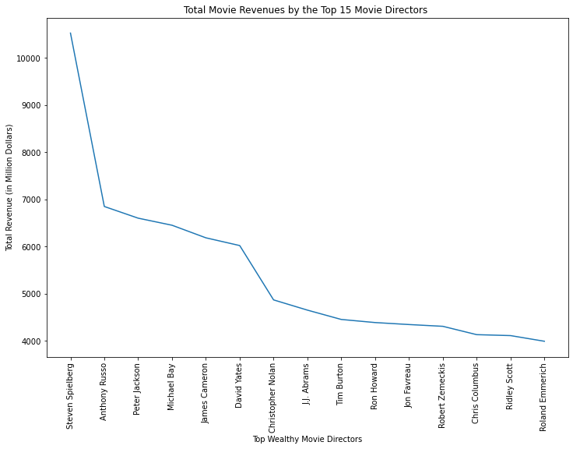
Directors vs. Revenue
Steven Spielberg has his total movie revenues of over 10 billion dollars, almost double the second highest director, Anthony Russo.
Panda weapons:
Group by method:
Grouped by directors and worldwide gross income
Filtered the top 15 most-wealthy directors

Slide 13
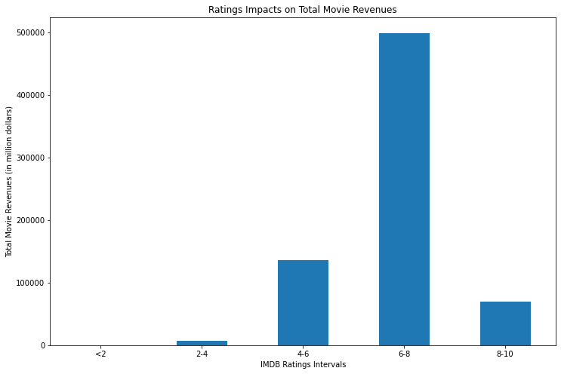
Movie ratings vs. Revenue
Similar to the ratings vs. award counts analysis, highest ratings do NOT necessarily result in highest revenues.
Possible reasons why:
Action movies has significantly higher revenues -> do NOT usually have 8-10 ratings
Most of the award-winning movies are Drama movies -> do likely to receive higher ratings but lower revenues

Slide 14
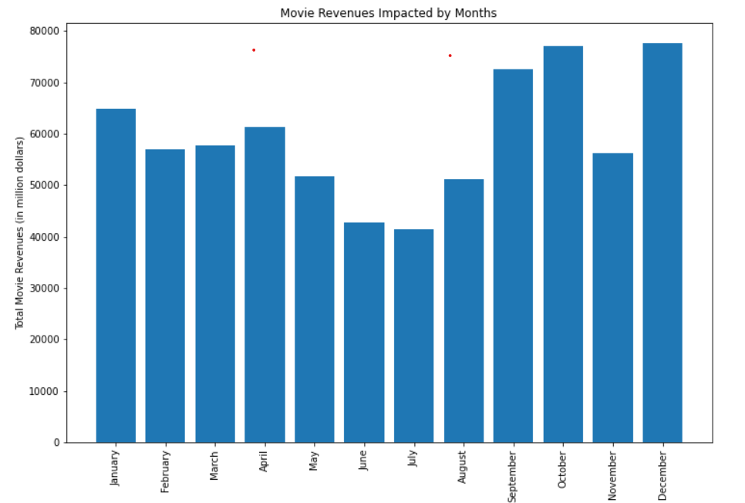
Time Frames vs. Revenue
To analyze if holiday time frames could result in higher revenue:
Targeted column: Date Published
Goal: Extract months from DD/MM/YYYY
Panda weapon:
Import packages (pip install)
Groupby month along with extract month (dt.srrftime(‘%B’)
Sort by month by referencing imported months-weekdays package
Covert $ amounts in millions dollars
Conclusion:
National holidays seem to earn more revenue.
Summer breaks, however, do not have much impact on gaining more revenue.

Slide 15
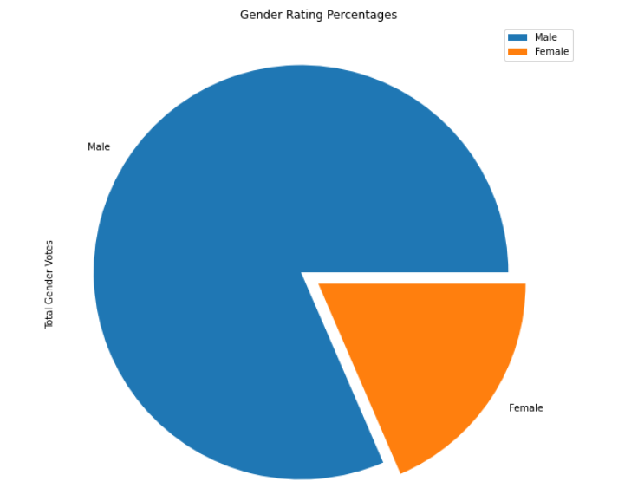
Audiences Impacts on Revenue
81% of the audience are male.
Possible conclusions to enhance previous analyses:
Male generally prefer action movies -> higher revenue on action movies
Action movies do NOT usually receive 8-10 scores -> low revenues in 8-10 rating interval

Slide 16
Conclusions

Slide 17

Award Winning Strategy Conclusions
The most awarded favored movie genre is Drama.
Certain directors may have huge impact on award winnings/nominations. Those directors are usually academy favored and have received significant recognitions on movie awards.
Movie ratings can be an impact to award winnings, but be mindful that we cannot “control” our ratings.

Slide 18

Revenue Conclusions
The most revenue driven movie genre is Action movie.
Certain directors/actors/actresses may be big revenue drivers
Movies released during national holidays can help boosting total revenue
Audience preferences can directly or indirectly impact the revenue

Slide 19


Limitations & Improvement
Directors/actors are impacting both ratings and revenue, but it’s expensive to hire top directors/actors
Profitability analysis could be made
Popular months may be too competitive, individual movies may end up to have lower revenue
Calculate the number of movies released in each months, then find the average revenue per movie by month
Monitor changes in audience preference that can directly/indirectly impacts revenue
Constant trend change in audience groups. Keep an ongoing analysis.

Slide 20
Q & A

